Slide 1
Image Gallery
TIW project 2021/2022
Laura Puccioni (10703762)
Pure HTML version

Slide 2
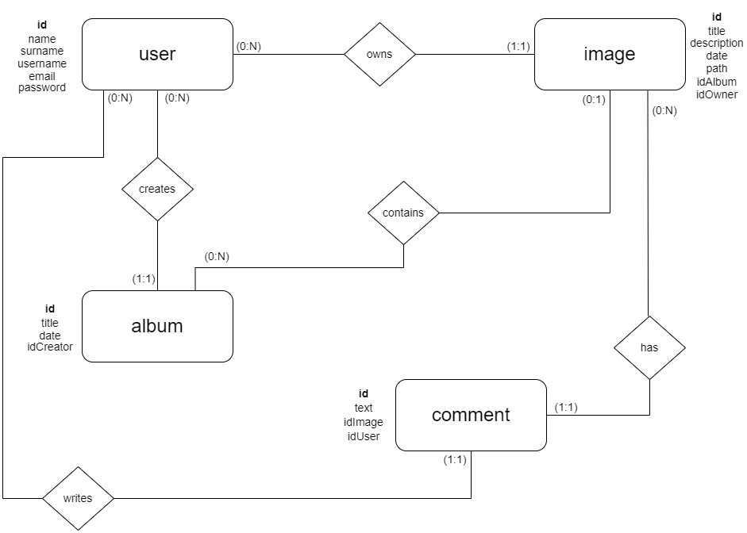

Slide 3
Local database schema
CREATE TABLE ‘user’ (
‘id’ INT NOT NULL AUTO_INCREMENT,
‘name’ VARCHAR(200) NOT NULL,
‘surname’ VARCHAR(200) NOT NULL,
‘username’ VARCHAR(200) NOT NULL,
‘email’ VARCHAR(200) NOT NULL, ‘password’ VARCHAR(50) NOT NULL,
‘albumOrder’ VARCHAR(255) DEFAULT NULL,
PRIMARY KEY (‘id’))
UNIQUE INDEX `username_UNIQUE` (`username` ASC) VISIBLE)
UNIQUE INDEX `email_UNIQUE` (`email` ASC) VISIBLE);
CREATE TABLE ‘album’ (
‘id’ INT NOT NULL AUTO_INCREMENT, ‘title’ VARCHAR(200) NOT NULL,
‘date’ DATE NOT NULL,
‘idCreator’ INT NOT NULL,
PRIMARY KEY (‘id’),
CONSTRAINT ‘creator_album’ FOREIGN KEY (‘idCreator’) REFERENCES ‘db_tiw_exam’.’user’ (‘id’) ON DELETE CASCADE ON UPDATE CASCADE);

Slide 4
CREATE TABLE ‘image’ (
‘id’ INT NOT NULL AUTO_INCREMENT, ‘title’ VARCHAR(200) NOT NULL, ‘description’ TEXT NOT NULL,
‘date’ DATE NOT NULL,
‘path’ VARCHAR(255) NOT NULL, ‘idOwner’ INT NOT NULL,
‘idAlbum’ INT DEFAULT NULL,
PRIMARY KEY (‘id’),
UNIQUE INDEX `path_UNIQUE` (‘path’ ASC) VISIBLE,
CONSTRAINT ‘owner_of_image’ FOREIGN KEY (‘idOwner’) REFERENCES ‘db_tiw_exam’.’user’ (‘id’) ON DELETE CASCADE ON UPDATE CASCADE);
CONSTRAINT ‘album_of_image’ FOREIGN KEY (‘idAlbum’) REFERENCES ‘db_tiw_exam’.’album’ (‘id’) ON DELETE SET NULL ON UPDATE CASCADE);
CREATE TABLE ‘comment’ (
‘id’ INT NOT NULL AUTO_INCREMENT, ‘text’ TEXT NOT NULL,
‘idImage’ INT NOT NULL,
‘idUser’ INT NOT NULL,
PRIMARY KEY (‘id’),
CONSTRAINT ‘image_comment’ FOREIGN KEY (‘idImage’) REFERENCES ‘db_tiw_exam’.’image’ (‘id’) ON DELETE CASCADE ON UPDATE CASCADE,
CONSTRAINT ‘user_comment’ FOREIGN KEY (‘idUser’) REFERENCES ‘db_tiw_exam’.’user’ (‘id’) ON DELETE CASCADE ON UPDATE CASCADE);

Slide 5
Completamento delle specifiche
La pagina di default contiene la form di login
Il login si può fare tramite username e password oppure tramite email e password, visto che anche quest’ultima deve essere unica nel database
Non possono esserci immagini duplicate (con lo stesso path) nel database
Ogni user può avere delle immagini che non appartengono a nessun album e che quindi possono essere aggiunte ad uno dei sui album
Quando un album viene creato viene assegnata ad esso la data del giorno stesso in cui viene creato

Slide 6
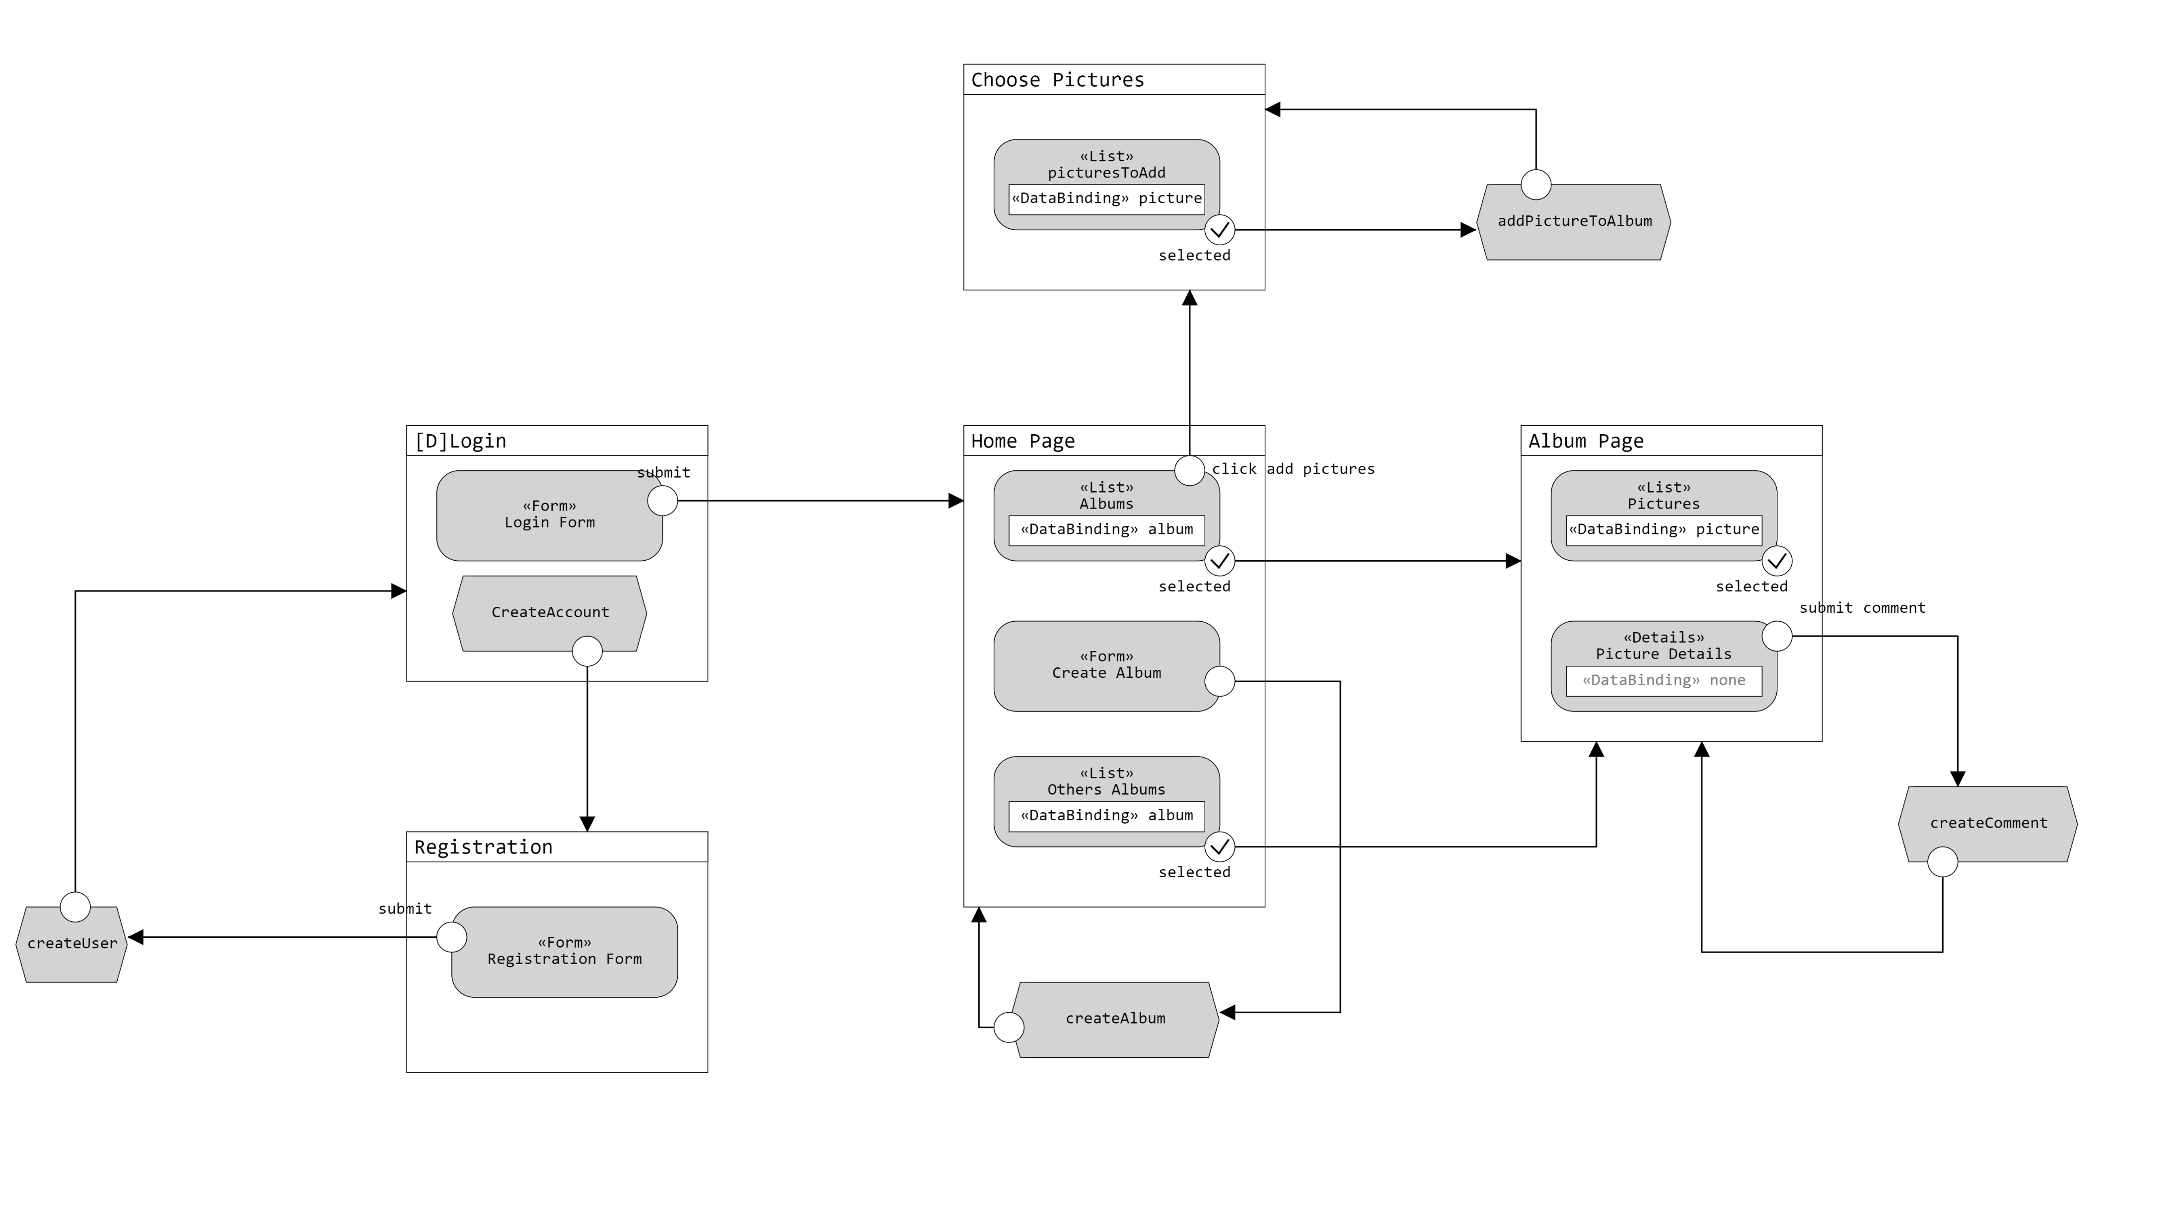
Application Design

Slide 7
Components (pure HTML version)
Model Objects (Beans)
Album
Comment
Image
User
Views
index.html
AlbumPage.html
ChoosePictures.html
HomePage.html
RegistrationForm.html
Utils
ConnectionHandler
Controllers (Servlets)
CheckLogin
Registration
GoToAlbumPage
CreateAlbum
CreateComment
AddToAlbum
GoToHomePage
GoToAddPictures
GoToRegistration
Logout
DAO
imageDAO
albumDAO
commentDAO
userDAO

Slide 8
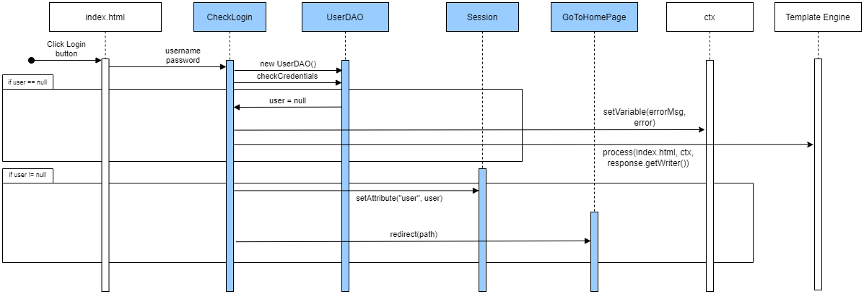
Event: login

Slide 9
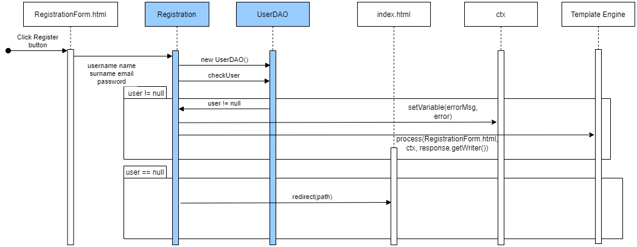
Event: Registration

Slide 10
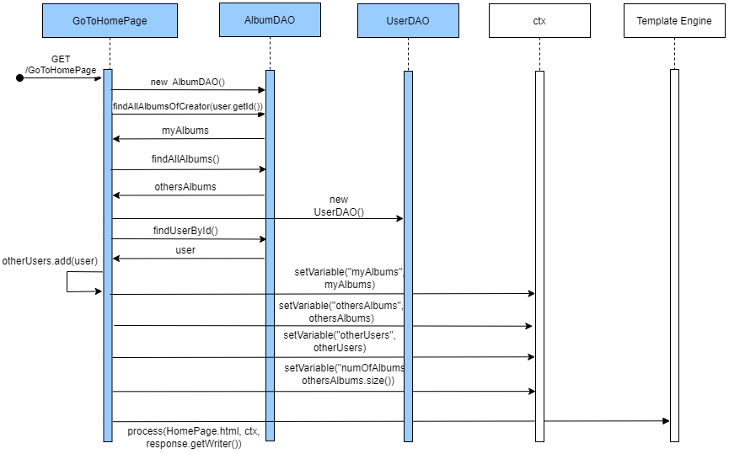
Event: go to Home Page

Slide 11
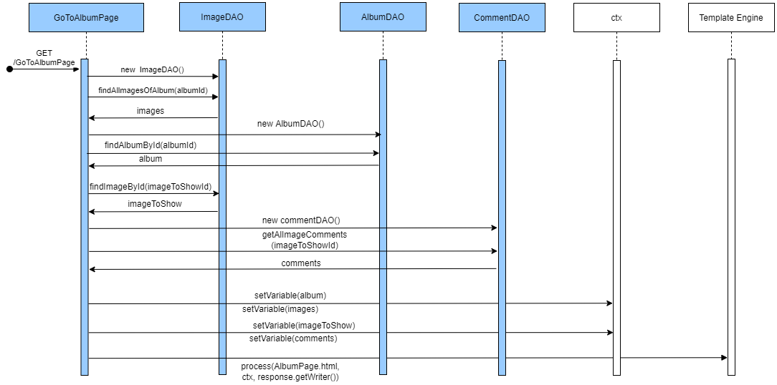
Event: Go to Album Page

Slide 12
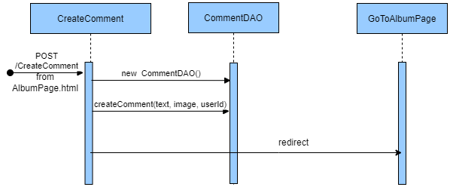
Event: create comment

Slide 13
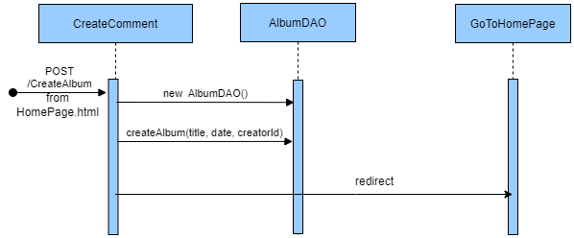
Event: create album

Slide 14
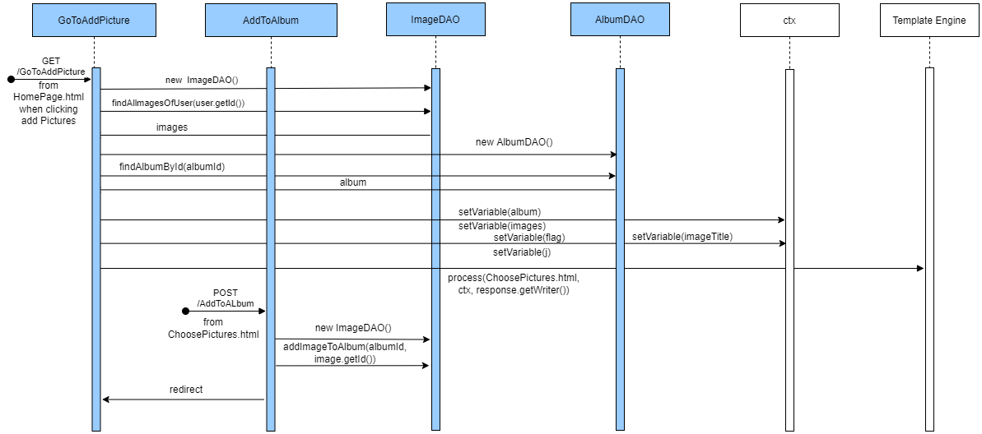
Event: add picture to album

Slide 15
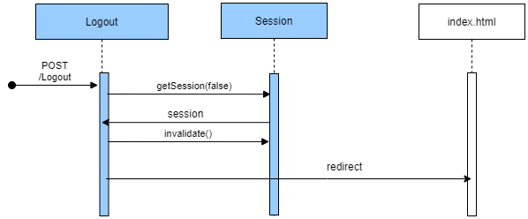
Event: Logout

